Slide 1
DAMN
DAphnia Metschnikowia Nanoplastics
Experiment

Slide 2

Proposed design:
2 (parasite / no parasite) x 3 (NP high/ NP low / control) x 2 (clones of Daphnia galeata)x 20 (replicates)
Nanoplastic concentrations
Control
Low
High
= 240 experimental units
Infected
Non-Infected
Is the host more likely susceptible to the parasite?
Intensity of infection
Does the nanoplastic concentration have any influence on the spread of diseases?
Notes:
We would like to answer the question if microplastic exposure affects host susceptibility to infection, so I would like to propose the following experimental design in order to do that.
we want to expose 2 clones of Daphnia galeata to two type of stressors: Infected and non-infected with the fungal parasite Metschikowia, and into three different concentrations of Nanoplastics control Low and high. This design will be replicated 20 times, giving us a total of 240 experimental units.
we would like to discuss :
If it is easier for the host to get infected in presence of nanoplastics
The intensity of infection. The proporsion of successfully terminally infected individuals..
And if the nanoplastics have any influence at the spread of diseases.

Slide 3
Size of experiment:
Parasite(y/n) | Nanoplastics concentrations (0,n,….) | Clones (AMME 03, 12, 51) | Replicates | Total number of jars | How many mothers would we need per clone?*
2 | 2 | 3 | 20/15 | 240/180 | 160/120
2 | 3 | 3 | 20/15 | 360/270 | 240/180
2 | 2 | 2 | 20/15 | 160/120 | 160/120
2 | 3 | 2 | 20/15 | 240/180 | 240/180
2 | 3 | 2 | 25 | 300 | 300
2 | 3 | 2 | 20 (+5extra) | 240 | 300
Thinking about it again, I would propose 20 replicates, BUT make one more jar with 5juveniles in it (in 25ml instaed of 5ml), these backup juviniles can then be used in case any Daphnia would be dead next day (i.e. after first transfer – meaning: due to experimental handling)
*calculation: 2 mothers per one juveline, on average
(currently we have per clone: 11jars x 20mothers = 220mothers)

Slide 4
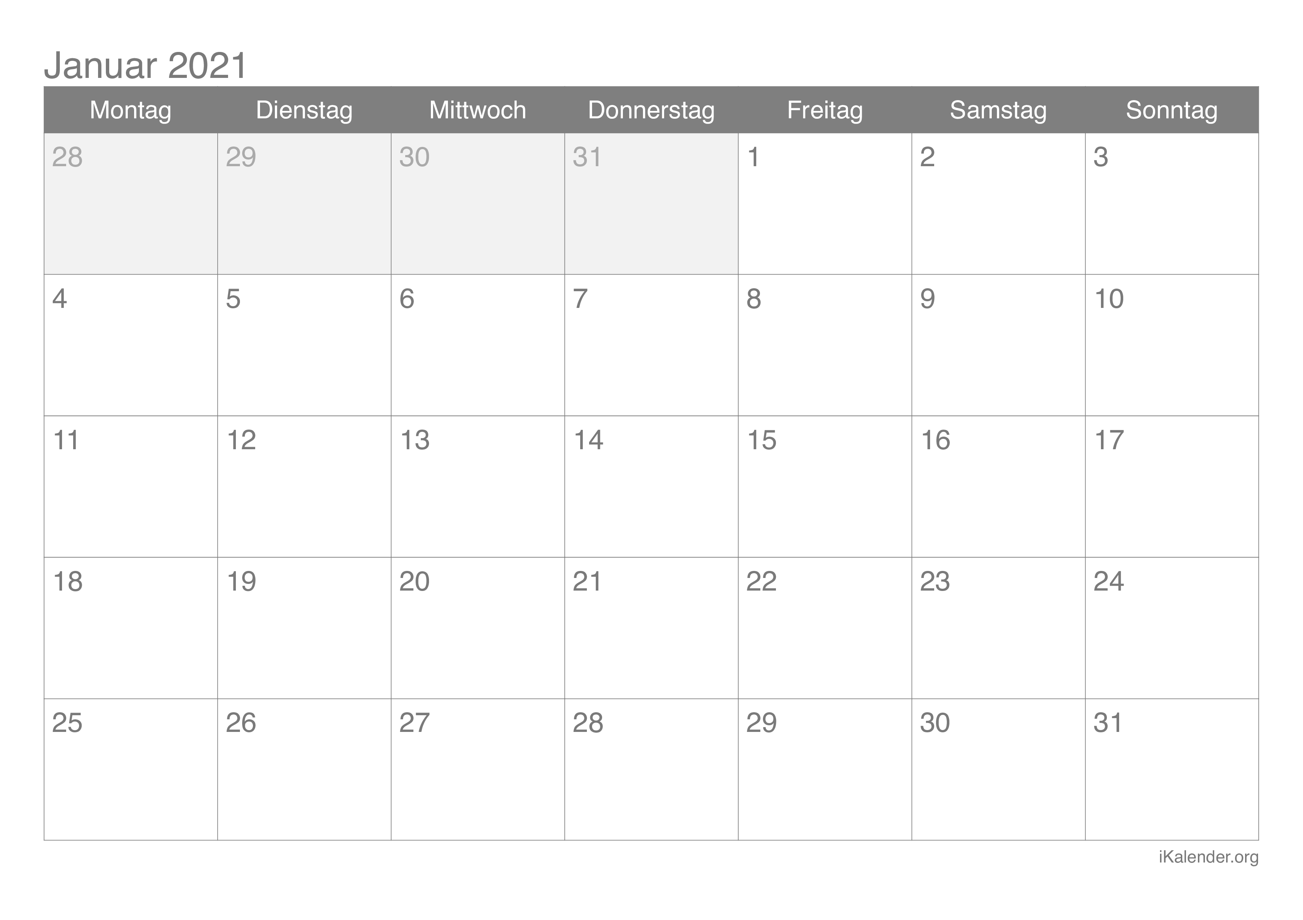
When would this experiment start?
Ma isolated (4 jars per clone)
Mb isolated (5 jars per clone)
Mc isolated (2 jars per clone)
Ma start reproducing (4 jars per clone)
Mb start reproducing (5 jars per clone)
Mc start reproducing (2 jars per clone)
Remove all juv
Collect juv for exp (by removing M), prepare NP solutions
Transfer juv to experimental jars
Parasite innoculation
Set up extra M from stocks, if needed

Slide 5
Important decisions to be taken (not necessarily today):
Which NP concentrations to use? (we need to make sure that with at least one concentration („low“) Daphnia will survive 10 days post-parasite exposure (as our question is: how NPs affect daphnia susceptibility?); with the second concentration („high“) Daphnia can be dead before we are able to assess them for infection (so we will test a bit different question here: how two stressors combined affect daphnia fitness?)
Which NPs do we use? (in terms of size and, also, old or new stocks): 100um, new stock
Feeding: how often? How much? Every day (except one parasite-innoculation day), 0.5C/ml
How often Daphnia need to be transfered to new media? Every four days
Which parasite doses should we use? (and is one inoculation enough?) 1000 spores / ml, one dose only
How to prepare experimental media? medium + NPs + food mixed in ISO bottles and then redistributed into the experimental jars. If 5ml – then electronic pipette. If 20ml, then “by hand”.

Slide 6
To do (in the coming days):
Wash experimental jars (done! Big thanks to Mareike!)
Find enough racks (for 240 jars plus some extras), and organize experimental space – Daphnia lab, clones need to be rearranched → Mareike
Prepare excel with labels for jars and eppendorfs → Steve
Label experimental jars and eppendorfs → Steve/Mareike (Noemi?)
Explain how to prepare Daphnia food of a given concentration → Charlotte
Make calculations for NP concentrations, dilutions → Charlotte
Make sure parasite spores are available → Florent
Prepare / print data collection spreadsheets → Steve (Florent, please share an example)
Juveniles need to be removed every second day from now on → Noemi/Steve, Mareike
For every medium change occasion, mixture is prepared (NP + food + medium). Distribution of media: first innocuation of 5ml (electronic pipet with a big tip) and later always 20ml (by hand).
Large ISO-flasks (three) and 100ml beakers (three) need to be washed (using the daphnia-glass method) → Mareike

